Slide 1




IBM Data Scientist
Ad Click Prediction
Dr: Eman Raslan

Slide 2


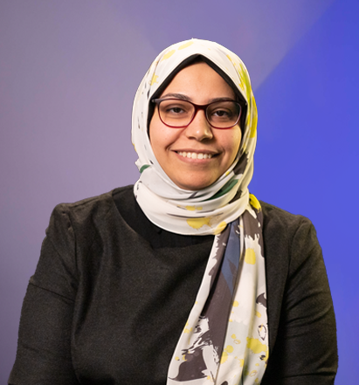
Dr. Eman Raslan
I would like to express my deepest gratitude for all the
effort, guidance, and support you have provided throughout my journey. Your dedication, patience, and commitment to helping me grow both academically and personally have made a profound impact on my development.
Thank you for always being available to offer advice and for pushing me to strive for excellence. Your mentorship has not only enhanced my knowledge but also inspired me to approach challenges with confidence and determination.
I truly appreciate everything you’ve done for me, and I look forward to applying the valuable lessons I've learned under your supervision.
Thank you once again for your hard work and continuous support

Slide 3

Team
1-Ahmed Mohamed AbdelSalam Ali Saber
2-Mohammed Hassan Mohammed Mohammed Saad
3-Hussein Mohamed Hussein Elwakeel
4-Noura Mohamed Hefzi
5-Basmala Mohamed Rashad
6-anglios gergs nagh

Slide 4
Introduction
Title: Predicting Ad Clicks Using Machine Learning
Introduction:
Objective: To understand the factors influencing user clicks on ads and develop a robust machine learning model for predicting ad clicks.
Highlight the importance of targeted advertising and how this model can improve ad efficiency.

Slide 5
Dataset Overview
An ad click prediction project involves using machine learning algorithms to predict the likelihood of a user clicking on a specific advertisement. It typically includes collecting and analyzing data on user behavior, ad features, and other relevant variables to create a model that can forecast whether a user is likely to click on an ad. The goal is to optimize advertising campaigns by targeting users more effectively and maximizing the click-through rate. The project requires data preprocessing, feature engineering, model training, evaluation, and deployment to make accurate predictions and enhance ad targeting strategies

Slide 6
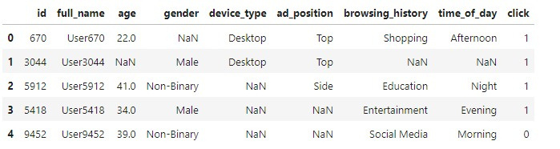
Exploratory Data Analysis (EDA)
Numerical Data:
Show summary statistics for numerical features like age.
Visualize age distribution with histograms.
Categorical Data:
Highlight unique values for features like gender, device type, and ad position.
Show pie charts of categorical distributions.

Slide 7
Data Cleaning &
Preprocessing
Data Cleaning:
Dropped unnecessary columns like ID and Full Name.
Handled missing values (categorical features filled with "Unknown", numerical features imputed using KNN).
Feature Engineering:
Created new feature: User Type (First-Time vs. Recurring Users).

Slide 8

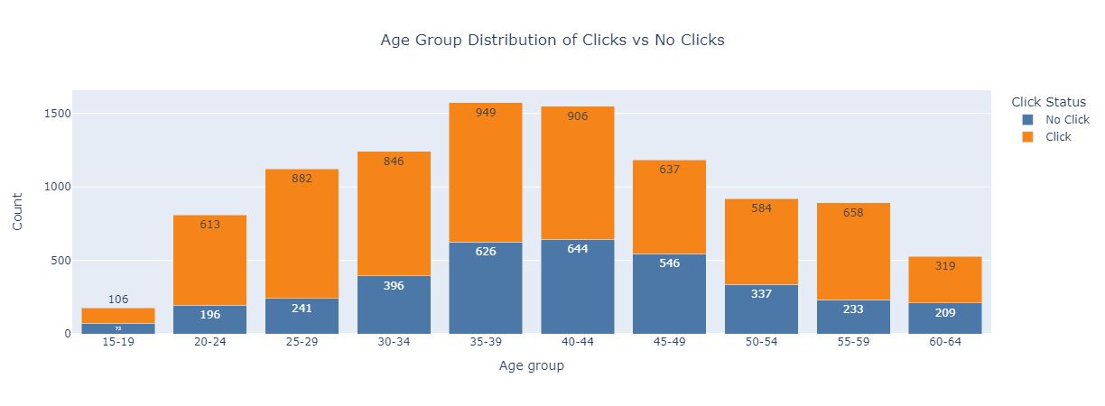
Visualization Insights
Key Visualizations:
Bar chart showing age group distribution for clicks and no-clicks.
Sunburst chart showing ad clicks by ad position.
Additional visualizations showing trends based on time of day and device type.

Slide 9
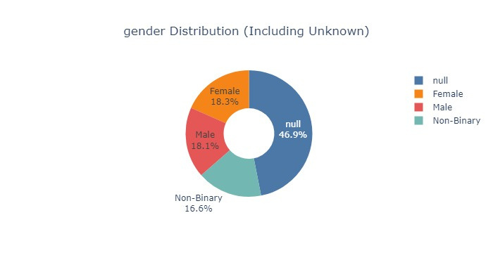
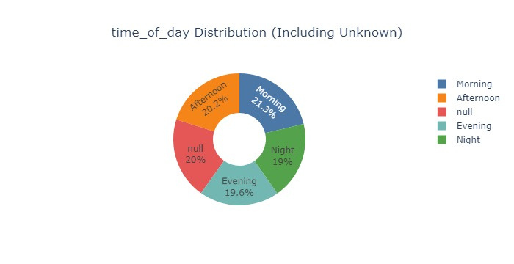
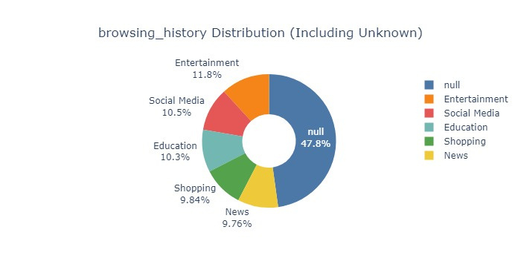
Visualization Insights

Slide 10
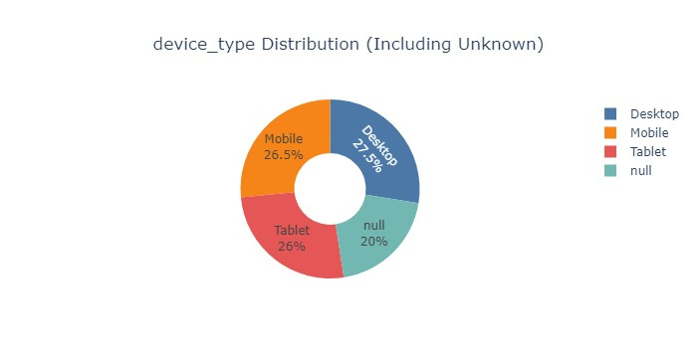
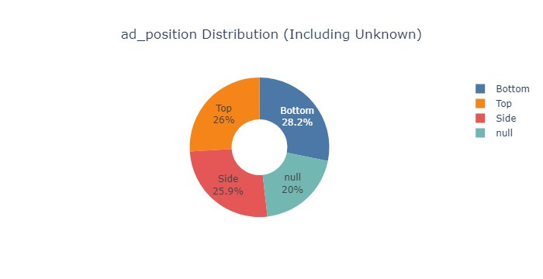
Visualization Insights

Slide 11
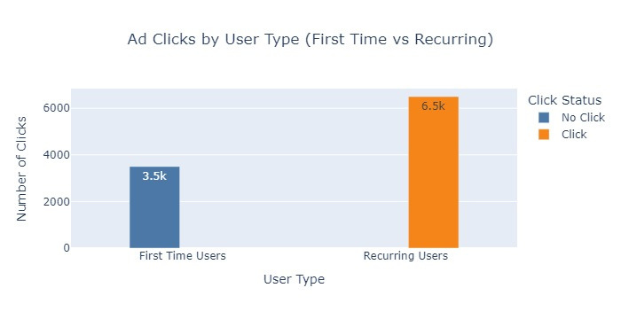
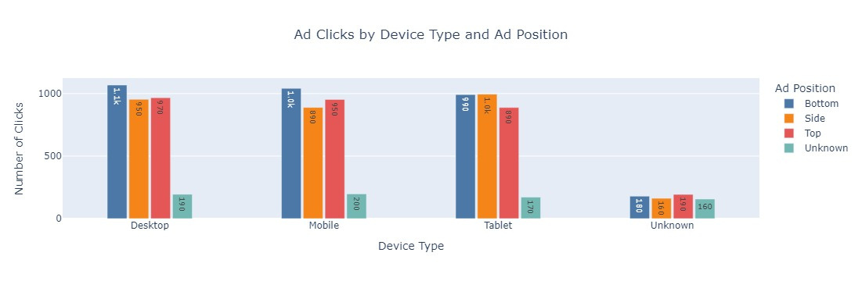
Visualization Insights

Slide 12
Model Building
Model: XGBoost Classifier with hyperparameter tuning (GridSearchCV).
Handling Imbalance: Applied ADASYN oversampling technique to balance the click/no-click data.
Preprocessing: Used OneHotEncoder for categorical variables.

Slide 13
Model Performance & Evaluation
Initial Model Results:
Display classification report: Precision, recall, F1-score.
Show confusion matrix as a heatmap to illustrate model performance.
Best Model:
Results after hyperparameter tuning (show the best parameters).

Slide 14
Model Deployment & Future Work
Deployment:
Saved the final model using Joblib for future use in production.
Next Steps:
Continuous improvement with further feature engineering and real-time predictions.

Slide 15
Prediction Example
Show a real-world example with sample input data (e.g., a 22-year-old user browsing in the afternoon) and the model's prediction (Click or No Click).

Slide 16
Conclusion
Summary:
Successfully predicted ad clicks using machine learning and identified key factors like age, ad position, and time of day.
Impact:
These insights can be used to improve targeted ad strategies and enhance user engagement.

Slide 17
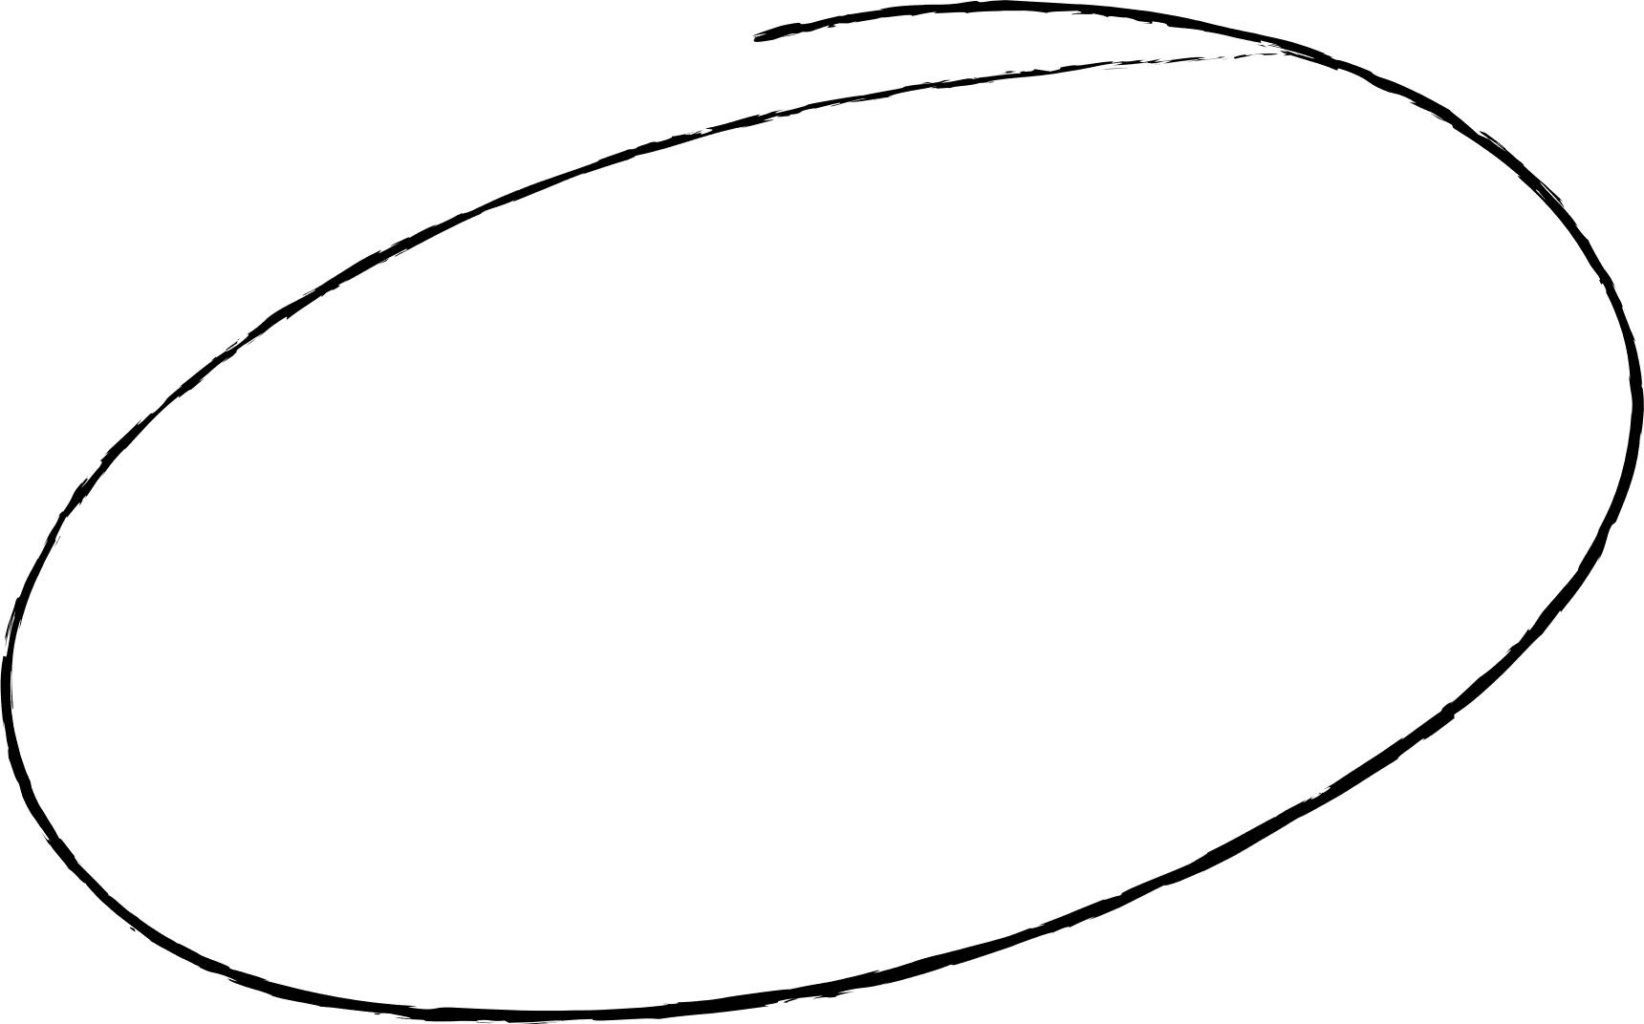
Thank you!

